Slide 1
Upcoming Assignments
9/6---
Self-Checks 8-15
Wed/Thurs
Self-Checks 16-17, 23, 26, 29, 30
Song Program-handout
Friday
Ex 2, 5, 9, 10, 13, 16
Song program
Monday 9/13
Quiz review
Tuesday 9/14
Song Program due
Quiz Chp 1

Slide 2
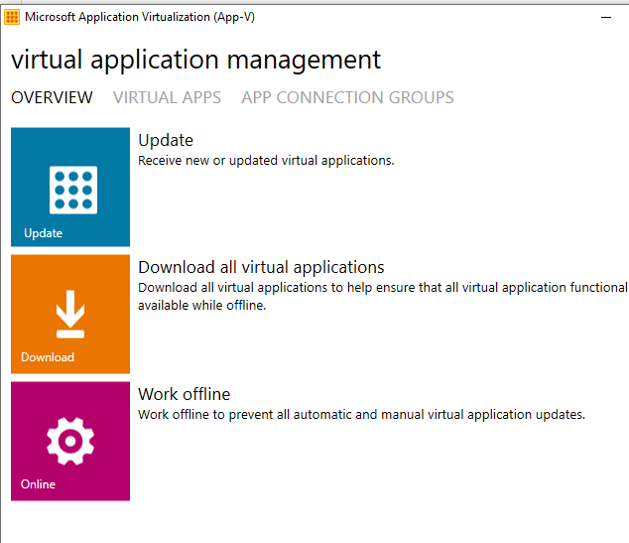
Click on Start > Microsoft App-V 5.0 Client UI:
Click on VIRTUAL APPS
Scroll down to the app that you need and click Download

Slide 3
1.3 Program Errors

Slide 4
Common Syntax Errors
Filename mismatches
Missing keywords
Mismatched Braces, Parenthesis, Brackets, Quotes
Missing terminator – semi-colon
Unresolved names

Slide 5
Filename Mismatch
The class name must match the filename
The class in the file Program.java must be named Program
The class Foo can only appear in a file called Foo.java
Case is significant
The class Test, cannot be in a file called test.java
Error: Could not find or load main class <Filename>

Slide 6
Missing main(String[] args)
Every program must have a main method
The method must be prefixed with public static void
The method must take a single parameter of type String[]
Right now our programs have only one class
That class must contain the main method
It will compile without a main method, but it will not run
Error: Main method not found in class Program,
please define the main method as:
public static void main(String[] args)

Slide 7
Missing Keywords
Some keywords are required
Classes require the keyword class
Eclipse error messages are not always intuitive
Error: Could not find or load main class <Filename>
Methods require a return type
So far we only know void
Error: Main method not found in class Program,
please define the main method as:
public static void main(String[] args)

Slide 8
Unresolved Name
public class Program {
public static void main(String[] args) {
System.out. ("Hello Interlake!");
}
}
Exception in thread "main" java.lang.Error: Unresolved compilation problem:
The method writeln(String) is undefined for the type PrintStream
at Program.main(Program.java:3)
writeln

Slide 9
1.4 Decomposition

Slide 10
Look For the Patterns
Go team, go!
You can do it.
Go team, go!
You can do it.
You’re the best.
In the West.
Go team, go!
You can do it.
Go team, go!
You can do it.
You’re the best.
In the West.
Go team, go!
You can do it.
Go team, go!
You can do it.

Slide 11
In Source Code
public static void main(
String[] args
) {
goTeam();
System.out.println();
stanza();
System.out.println();
stanza();
System.out.println();
goTeam();
}
public static void stanza() {
goTeam();
theBest();
goTeam();
}
public static void goTeam() {
System.out.println("Go team, go!");
System.out.println("You can do it.");
}
public static void theBest() {
System.out.println("You’re the best.");
System.out.println("In the West.");
}

Slide 12
Program Decomposition
If you want to print the same thing 100 times
How would you do it?
System.out.println("I will not hide the teachers ... ");
One obvious way is to cut and paste the line 100 times
System.out.println("I will not hide the teachers ... ");
System.out.println("I will not hide the teachers ... ");
System.out.println("I will not hide the teachers ... ");
System.out.println("I will not hide the teachers ... ");

Slide 13
Tomorrow Is Another Day
Something different?
It is tedious and error prone to change all 100 lines
Instead, we replace the println with a different method
private static void writeOnChalkboard() {
System.out.println("Fun does not have a size");
}
And then call the method
writeOnChalkboard();
Notes:
Animation 1, uses our incantation of “private static void”.
Animation 2, has no parameters

Slide 14
Something Like This
public static void main(String[] args) {
writeOnChalkboard();
writeOnChalkboard();
writeOnChalkboard();
.
.
}
public static void writeOnChalkboard() {
System.out.println("This counts as gym and art class");
}
Methods call other methods?--show
Notes:
Now we only have to change what is written in exactly one place.

Slide 15
100 lines
In eclipse write a program that prints out “I love to write code”, 100 times
Using methods, in how few lines can your program accomplish the task.
Use only 1 print statement
Sorry no loops allowed
Turn in .java to the dropbox
This PC->fileserver-CTE>Dropbox>Peterson>Period>100lines
Make a subfolder with you lastnamefirstname
R-click – Show in—System Explorer

Slide 16
Upcoming Assignments
9/6---
Self-Checks 8-15
Wed/Thurs
Self-Checks 16-17, 23, 26, 29, 30
Song Program-handout
Friday
Ex 2, 5, 9, 10, 13, 16
Song program
Monday 9/13
Quiz review
Tuesday 9/14
Song Program due
Quiz Chp 1

